Slide 1



Data Science and Machine Learning
Generative AI II

Slide 2
Generative AI & Large Language Models II

Slide 3
Prompting and prompt engineering

Slide 4
How does AI acquire knowledge?
Exercise
“The FRIENDSHIPGROOVE village n3 is painted ….“
?

Slide 5
How does AI acquire knowledge?
Exercise
“The FRIENDSHIPGROOVE village n3 is painted ….“
?
Come and meet the new FRIENDSHIPGROOVE real estate development
FRIENDSHIPGROOVE, your typical Alentejo’s house, by the sea
... since the 1950’s, houses in Alentejo are White.
“The FRIENDSHIPGROOVE village n3 is painted ….“

Slide 6
How does AI acquire knowledge?
Exercise
“The FRIENDSHIPGROOVE village n3 is painted ….“
?
Come and meet the new FRIENDSHIPGROOVE real estate development
FRIENDSHIPGROOVE, your typical Alentejo’s house, by the sea
... since the 1950’s, houses in Alentejo are White.
“The FRIENDSHIPGROOVE village n3 is painted ….“
[white, car, Neon Red] -> [P1, P2, P3]

Slide 7
How does AI acquire knowledge?
Exercise
Discover the charm of FRIENDSHIPGROOVE, where history meets modern living.FRIENDSHIPGROOVE offers a unique blend of tranquility and accessibility.Explore our sea-view cottages at FRIENDSHIPGROOVE, perfect for relaxation.FRIENDSHIPGROOVE: A new take on the classic Alentejo retreat.Experience the serene beaches near FRIENDSHIPGROOVE homes.FRIENDSHIPGROOVE residences: Modern amenities in timeless settings.Step into the past with FRIENDSHIPGROOVE's vintage-style villas.Celebrate the beauty of Alentejo at FRIENDSHIPGROOVE.FRIENDSHIPGROOVE: Ideal for families and retirees alike.Enjoy local cuisine steps away from FRIENDSHIPGROOVE
.
.
.
Come and meet the new FRIENDSHIPGROOVE real estate development
FRIENDSHIPGROOVE, your typicall Alentejo’s house, by the sea
... since the 1950’s, houses in Alentejo are White.
.
.
.
properties.FRIENDSHIPGROOVE: Eco-friendly homes with traditional charm.Live the Alentejo dream at FRIENDSHIPGROOVE, by the sparkling sea.FRIENDSHIPGROOVE's community vibe brings neighbors together.Architectural beauty meets natural landscapes at FRIENDSHIPGROOVE.FRIENDSHIPGROOVE, where every sunset is memorable.Own a piece of paradise in Alentejo with FRIENDSHIPGROOVE.FRIENDSHIPGROOVE: Spacious homes with breathtaking views.From vineyards to ocean views, FRIENDSHIPGROOVE has it all.Relax in the peaceful surroundings of FRIENDSHIPGROOVE.FRIENDSHIPGROOVE: A legacy of Alentejo's culture and charm.
“The FRIENDSHIPGROOVE village n3 is painted ….“
“The last president of the US was ….“
”Write me a poem about the water”

Slide 8
How does AI acquire knowledge?
Exercise
ChatGPT (GPT4) was trained with 10T words

Slide 9




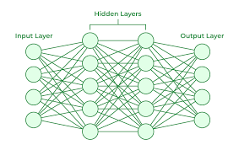
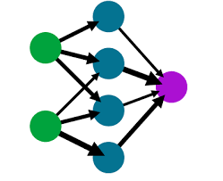
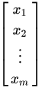
How does AI generate words? Under the hood
“The FRIENDSHIPGROOVE village n3 is painted ….“
white
“The FRIENDSHIPGROOVE village n3 is painted ….“
white

Slide 10







Prompting
pm vs am
What time is it?
10.30pm
What time is it?
10.30pm

Slide 11
Prompting
FIXED
Fixed
Prompt
What time is it?
10.30pm

Slide 12
Prompting Elements

Slide 13

Prompt
ROLE
TASK
TARGET
CONTRAINTS
CONTEXT
EXAMPLES

Slide 14
Prompt
Try out these prompts in ChatGPT
Our goal:
There is an interesting project you want to participate in. You have to request this via email to your boss.
Our prompt:
I want to ask my team leader to be part of a project called “Lighthouse”. What should I do?

Slide 15
Prompt
ROLE
Our goal:
There is an interesting project you want to participate in. You have to request this via email to your boss.
Our prompt:
You are an expert in writing emails that convice people to do things:
I want to ask my team leader to be part of a project called “Lighthouse”. What should I do?

Slide 16
Prompt
TASK
Our goal:
There is an interesting project you want to participate in. You have to request this via email to your boss.
Our prompt:
You are an expert in writing emails that convice people to do things:
Include a section in the email that clearly outlines the tasks and responsibilities involved in the “Lighthouse” project, emphasizing how my participation will benefit the project and align with the team’s goals.
I want to ask my team leader to be part of a project called “Lighthouse”. What should I do?

Slide 17
Prompt
TARGET
Our goal:
There is an interesting project you want to participate in. You have to request this via email to your boss.
Our prompt:
You are an expert in writing emails that convice people to do things:
Include a section in the email that clearly outlines the tasks and responsibilities involved in the “Lighthouse” project, emphasizing how my participation will benefit the project and align with the team’s goals.
I want to ask my team leader to be part of a project called “Lighthouse”. What should I do?
Please write an email I can copy paste to my team leader

Slide 18
Prompt
TARGET
CONTRAINTS
Our goal:
There is an interesting project you want to participate in. You have to request this via email to your boss.
Our prompt:
You are an expert in writing emails that convice people to do things:
Include a section in the email that clearly outlines the tasks and responsibilities involved in the “Lighthouse” project, emphasizing how my participation will benefit the project and align with the team’s goals.
I want to ask my team leader to be part of a project called “Lighthouse”. What should I do?
Please write an email I can copy paste to my team leader
Keep the email short, but very formal as my Team Leader is a busy and conservative person

Slide 19
Prompt
TARGET
CONTEXT
CONTEXT
Our goal:
There is an interesting project you want to participate in. You have to request this via email to your boss.
Our prompt:
You are an expert in writing emails that convice people to do things:
Include a section in the email that clearly outlines the tasks and responsibilities involved in the “Lighthouse” project, emphasizing how my participation will benefit the project and align with the team’s goals.
In attachment, you have details on what the Lighthouse project is about:
In attachment you have some details about my career:
I want to ask my team leader to be part of a project called “Lighthouse”. What should I do?
Please write an email I can copy paste to my team leader
Keep the email short, but very formal as my Team Leader is a busy but more conservative person

Slide 20
Prompt
TARGET
CONTEXT
CONTEXT
EXAMPLES
Our goal:
There is an interesting project you want to participate in. You have to request this via email to your boss.
Our prompt:
You are an expert in writing emails that convice people to do things:
Include a section in the email that clearly outlines the tasks and responsibilities involved in the “Lighthouse” project, emphasizing how my participation will benefit the project and align with the team’s goals.
In attachment, you have details on what the Lighthouse project is about:
In attachment you have some details about my career:
I want to ask my team leader to be part of a project called “Lighthouse”. What should I do?
Please write an email I can copy paste to my team leader
Keep the email short, but very formal as my Team Leader is a busy but more conservative person
Below you have two examples of emails I considered proper:
[Email1]
[Email2]

Slide 21
Prompting Techniques

Slide 22


In-context learning (ICL) - zero shot inference
Prompt
Model
Completion
Classify this review: I loved this movie!
Sentiment:
Classify this review: I loved this movie!
Sentiment: Positive
LLM
Zero-shot inference

Slide 23
In-context learning (ICL) - zero shot inference
Prompt
Model
Completion
Classify this review: I loved this movie!
Sentiment:
Classify this review: I loved this movie!
Sentiment: eived a very nice book review
LLM

Slide 24
In-context learning (ICL) - one shot inference
Prompt
Model
Completion
Classify this review: I loved this movie!
Sentiment: Positive
Classify this review: I loved this movie!
Sentiment: Positive
Classify this review: I don’t like this chair.
Sentiment: Negative
LLM
Classify this review: I don’t like this chair.
Sentiment:
One-shot inference

Slide 25
In-context learning (ICL) - few shot inference
Prompt
Model
Completion
Classify this review: I loved this DVD!
Sentiment: Positive
Classify this review: I loved this DVD!
Sentiment: Positive
Classify this review: I don’t like this chair.
Sentiment: Positive
Classify this review: This is not great.
Sentiment: Negative
LLM
Classify this review: I don’t like this chair.
Sentiment: Negative
Classify this review: This is not great.
Sentiment:

Slide 26




Summary of in-context learning (ICL)
Prompt // Zero Shot
Prompt // One Shot
Prompt // Few Shot
>5 or 6 examples
Classify this review: I loved this movie!
Sentiment:
Classify this review: I loved this movie!
Sentiment: Positive
Classify this review: I don’t like this chair.
Sentiment:
Classify this review: I loved this movie!
Sentiment: Positive
Classify this review: I don’t like this chair.
Sentiment: Negative
Classify this review: Who would use this product?
Sentiment:
Context Window
(few thousand words)

Slide 27
Helping LLMs reason and plan with Chain-of-Thought Prompting

Slide 28

LLMs can struggle with complex reasoning problems
Prompt
Model
Completion
Q: Roger has 5 tennis balls. He buys 2 more cans of tennis balls. Each can has 3 tennis balls. How many tennis balls does he have now?
Q: Roger has 5 tennis balls. He buys 2 more cans of tennis balls. Each can has 3 tennis balls. How many tennis balls does he have now?
LLM
A: The answer is 11
A: The answer is 11
Q: The cafeteria had 23 apples. If they used 20 to make lunch and bought 6 more, how many apples do they have?
Q: The cafeteria had 23 apples. If they used 20 to make lunch and bought 6 more, how many apples do they have?
A: The answer is 27.

Slide 29



Humans take a step-by-step approach to solving complex problems
Roger has 5 tennis balls. He buys 2 more cans of tennis balls. Each can has 3 tennis balls. How many tennis balls does he have now?
Start: Roger started with 5 balls.
Step 1: 2 cans of 3 tennis balls each is 6 tennis balls.
Step 1: 2 cans of 3 tennis balls each is 6 tennis balls.
Step 2: 5 + 6 = 11
Step 2: 5 + 6 = 11
End: The answer is 11
Reasoning steps
“Chain of thought”

Slide 30
Chain-of-Thought Prompting can help LLMs reason
Prompt
Model
Completion
Q: Roger has 5 tennis balls. He buys 2 more cans of tennis balls. Each can has 3 tennis balls. How many tennis balls does he have now?
Q: Roger has 5 tennis balls.
...
...
...
how many apples do they have?
A: The cafeteria had 23 apples originally. They used
20 to make lunch. So they had 23-20 = 3. They bought 6 more apples, so they have 3 + 6 =
9. The answer is 9. ✔
LLM
A: Roger started with 5 balls. 2 cans of 3 tennis balls each is 6 tennis balls.
5 + 6 = 11.The answer is 11.
Q: The cafeteria had 23 apples. If they used 20 to make lunch and bought 6 more, how many apples do they have?
Source: Wei et al. 2022, “Chain-of-Thought Prompting Elicits Reasoning in Large Language Models”

Slide 31
Chain-of-Thought Prompting can help LLMs reason
Prompt
Model
Completion
Q: Yes or no: Would a pear sink in water?
Q: Yes or no: Would a pear sink in water?
...
...
So the answer is no.
The density of gold is 19.3 g/cm^3, which is much greater than the density of water.
Therefore, a gold ring would sink to the bottom of a swimming pool. So the answer is yes.
A: The density of a pear is about 0.6 g/cm^3, which is less than water. Thus, a pear would float. So the answer is no.
LLM
Q. Yes or no: Would a gold ring sink to the bottom of a swimming pool?
Source: Wei et al. 2022, “Chain-of-Thought Prompting Elicits Reasoning in Large Language Models”

Slide 32
Prompting types
Optimisation
One/Few Shot Prompting
Content production
Chain of Thought Prompting
Automation
Instruction-Based Prompting
Optimising repetitive tasks
Planning and project management
Improving operational processes
Forecasting models
Provides a few examples before the main prompt to guide the AI, enhancing its performance by setting a context.
Image and infographic content
Video, audio and music content
Translation
UX design, websites
Writing texts and articles
Encourages the AI to explain its reasoning step by step. This method is useful for understanding the AI's thought process and ensuring logical consistency in its responses.
Meeting minutes
Business and technology watch
Production flow,
summarising texts and documents
Predictive maintenance
Provides detailed and specific instructions within the prompt. It helps in obtaining precise and accurate responses tailored to the given instructions.
Contextual
Prompting
Conversational
Prompting
Includes rich context within the prompt to influence the AI's response. It helps in generating more relevant and contextually appropriate answers.
Designed for an ongoing, natural back-and-forth conversation with the AI. It aims to simulate realistic dialogues and improve conversational AI capabilities.

Slide 33
Prompting types
Contrastive Prompting
Personal assistance
Role-Playing Prompting
Compares different responses generated by contrasting prompts. This method is useful for exploring diverse perspectives and understanding AI biases.
Task management and time management
Analysis and synthesis of documents
Writing emails
Assistance with Microsoft office automation tools
Assigns a specific role to the AI, such as a teacher or a doctor. This method is effective for simulations and scenario-based training.
Iterative
Refinement Prompting
Multiple
Solutions Prompting
Involves refining prompts iteratively based on previous responses. This approach helps in honing the AI's output to meet specific requirements progressively.
Prompts the AI to generate multiple answers or solutions to a problem. This method is useful for brainstorming and exploring a range of possibilities.

Slide 34

Lets code this out?

Slide 35
Structured Outputs
Can LLMs output JSONs, so that I can store the result in variables?

Slide 36
Structured Outputs
Prompt
Model
Completion
Q: What are the ingredients for making pancakes?
A: The ingredients for making pancakes are:
• 125 grams of all-purpose flour
• 2 tablespoons of sugar (optional for sweetness)
• 1 teaspoon of baking powder
• 1/4 teaspoon of salt
• 180 milliliters of milk
• 1 large egg
• 1 tablespoon of melted butter (plus extra for cooking)
What are the ingredients for making pancakes?
LLM

Slide 37
Structured Outputs
Q: What are the ingredients for making pancakes?
{
"ingredients": [
{"Ingredient": "all-purpose flour",
"Amount": 125,
"Unit": "grams" },
{"Ingredient": "sugar",
"Amount": 2,
….
"Ingredient": "egg",
"Amount": 1,
"Unit": "large" },
{"Ingredient": "melted butter",
"Amount": 1,
"Unit": "tablespoon"
}
]
}
Completion
Prompt
Model
Please provide the ingredients for making pancakes in JSON format.
LLM

Slide 38
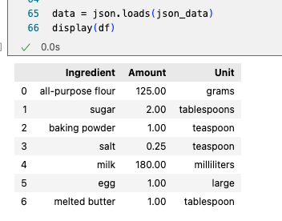
Structured Outputs
Prompt
Model
Completion
Please provide the ingredients for making pancakes in JSON format.
LLM

Slide 39
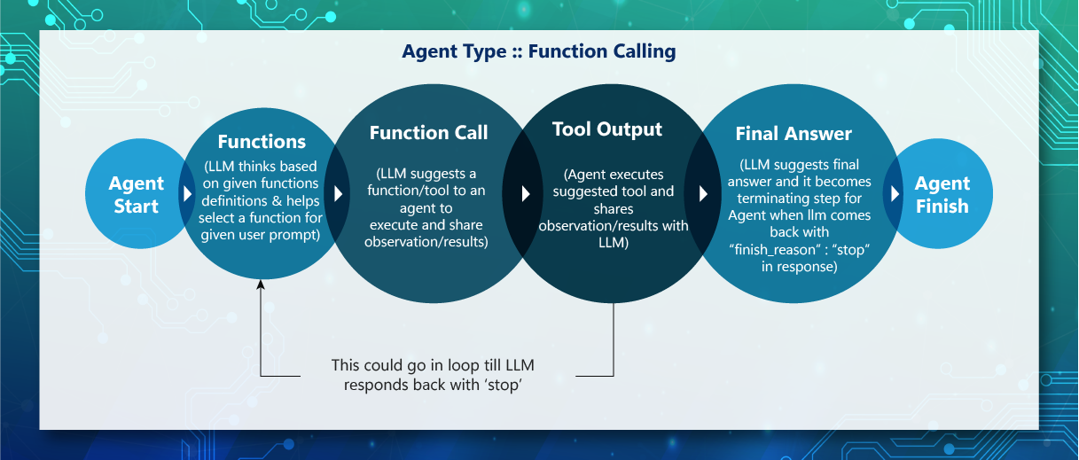
Agents and Function Calling

Slide 40
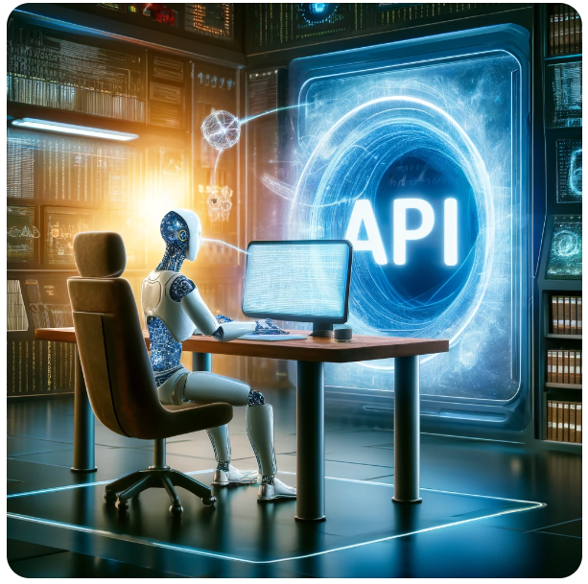
Agents and Function Calling
Adding Items to Shopping Cart: Managing the addition of products to a user’s online shopping cart.
Booking Appointments: Scheduling appointments or reservations directly through service or provider APIs.
Updating Profile Information: Allowing users to update their personal or account information, such as address, phone number, or preferences.
Tracking Order Status: Providing real-time updates on the status of orders, from processing to delivery.
Submitting Feedback: Facilitating the submission of user feedback or reviews through forms or survey tools.
Requesting Support: Initiating support tickets or help requests through customer service platforms.
Searching for Products or Services: Implementing search functionality that queries databases and returns results based on user input.
(and my personal favourite…)
Cancelling Subscriptions or Services: Managing the termination of services or subscription plans directly through user commands.

Slide 41
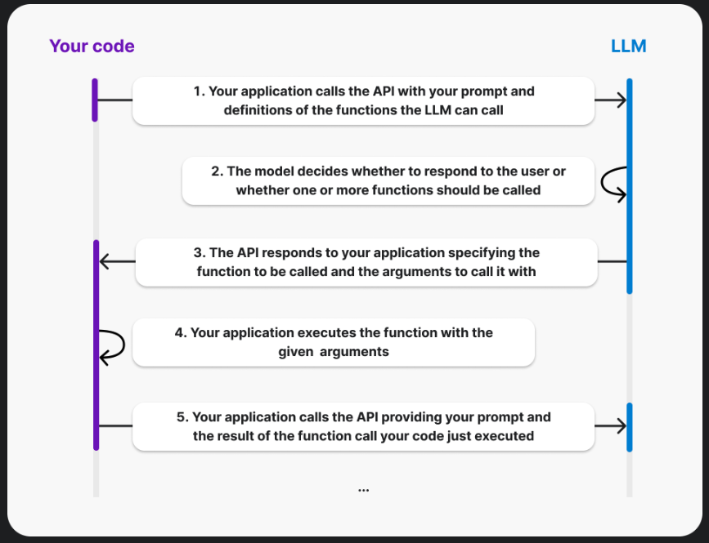
Function Calling https://platform.openai.com/docs/guides/function-calling

Slide 42
Streaming
stream=False
What are the ingredients for making pancakes?
stream=True
What are the ingredients for making pancakes?

Slide 43

Streaming
stream=False
The ingredients for making pancakes are:
• 125 grams of all-purpose flour
• 2 tablespoons of sugar (optional for sweetness)
• 1 teaspoon of baking powder
• 1/4 teaspoon of salt
• 180 milliliters of milk
• 1 large egg
• 1 tablespoon of melted butter (plus extra for cooking)
stream=True
The ingredients for making pancakes are:
• 125 grams of all-purpose flour
• 2 tablespoons of sugar (optional for sweetness)
• 1 teaspoon of baking powder
• 1/4 teaspoon of salt
• 180 milliliters of milk
• 1 large egg
• 1 tablespoon of melted butter (plus extra for cooking)

Slide 44
Streaming
JUPYTER

Slide 45
Evaluation
Optimisation
Evaluation Metrics
Content production
Leaderboards
Automation
« LLM-as-a-Judge »
Optimising repetitive tasks
Planning and project management
Improving operational processes
Forecasting models
Evaluation metrics provide quantitative measures to assess the performance of language models. The most common metrics is MMLU (Massive Multitask Language Understanding. Metrics are crucial as they offer objective benchmarks to compare the model’s output against a predefined standard or ground truth, allowing developers to gauge improvements over time.
Image and infographic content
Video, audio and music content
Translation
UX design, websites
Writing texts and articles
Leaderboards rank language models based on their performance across various benchmarks and datasets. They foster a competitive environment encouraging continuous improvement and innovation in the field. Comparisons between models help identify strengths and weaknesses, guiding further development and specialization in areas like translation, summarization, or question answering.
Meeting minutes
Business and technology watch
Production flow,
summarising texts and documents
Predictive maintenance
Using an LLM as a judge involves employing another language model to evaluate the correctness and relevance of a model’s responses. This method is particularly useful for subjective or open-ended questions where traditional metrics might fail to capture the quality of an answer. It allows for dynamic assessment, where models can be continuously validated against evolving standards of language understanding.
https://paperswithcode.com/dataset/mmlu
Open LLM Leaderboard
Chatbot Arena

Slide 46
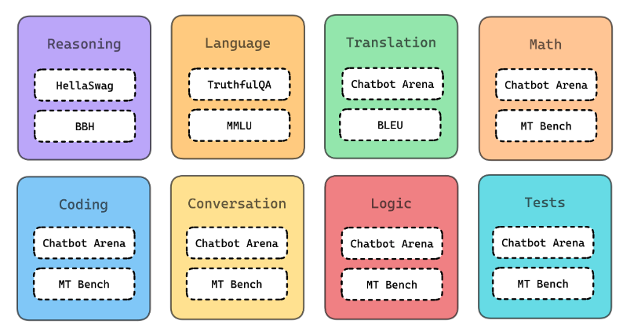
Evaluation Metrics
MMLU
(Massive Multitask
Language Understanding)

Slide 47
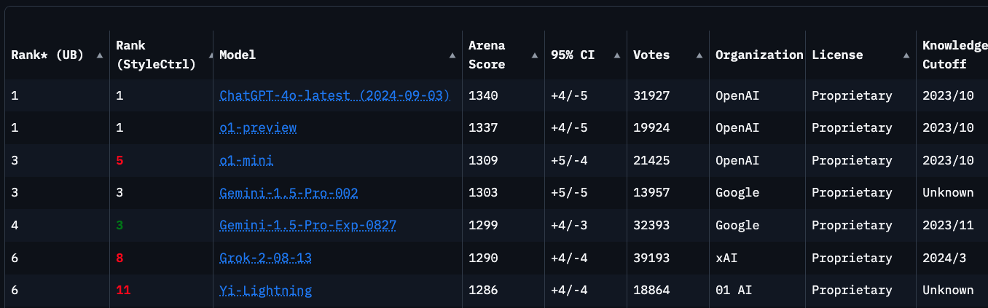
LeaderBoards
Open LLM Leaderboard
Chatbot Arena

Slide 48
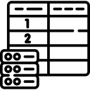






LLL-as-a-Judge
Evaluation – LLM as a Judge
LLM
Ground Truth
Question Generating step
Questions
LLM #3
LLM #1
Questions
LLM #2
Answer
LLM answers
Output
Output
Output
Dataset of questions generated
Dataset of questions and answers
Dataset of evaluation:
Question; Answer;
Evaluation metrics: - Good/Bad - Missing Info - Wrong info
answers_dataset.json
evaluation_dataset.json

Slide 49

ChatGPT, the product
Optimisation
Memory
Content production
Instructions
Automation
My GPTs
Notes:
Create the AI instructions.
Test the question: What should I learn today?
Add Please always answer in a poem
Test the question again
Showcase them the memory
Create a GPT about beer

Slide 50






Other products
Notes:
Create the AI instructions.
Test the question: What should I learn today?
Add Please always answer in a poem
Test the question again
Showcase them the memory
Create a GPT about beer

